Slide 1

Chapter 5 Stacks and Queues

Slide 2

Outline
A Different Kind of Structure
Stacks(栈)
Queues（队列）
Priority Queues（优先队列）
Parsing Arithmetic Expressions*（解析算术表达式）

Slide 3
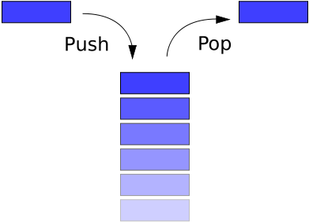
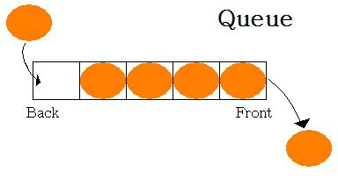
A Different Kind of Structure
Used in a database application. Make it easy to insert, delete, and search for particular items.
Programmer’s Tools
Arrays & Linked lists & Trees
Stacks & Queues
Primarily conceptual aids
Lifetime is typically shorter
TOP
Stack
BOTTOM

Slide 4
A Different Kind of Structure
Restricted Access（受限的操作）
Only the item at a given place can be read or removed
只有某个特定位置的元素可以被读取或者删除
The interface of these structures is designed to enforce(实现) this restricted access.
More Abstract
The underlying mechanism used to implement them is typically not visible to their user.
其后台实现机制对用户而言，通常是不可见的。
Stack（Array or LinkList） Queue（Array or Heap）

Slide 5
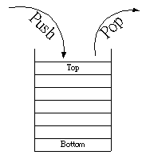





Stacks
Allows access to only one data item: the last item inserted and deleted.
This capability is useful in many programming situations
Parse (analyze) arithmetic expressions
Help traverse the nodes of a tree. （遍历树节点）
Search the vertices of a graph (a technique that can be used to find your way out of a maze).
Microprocessor
Pocket calculators

Slide 6

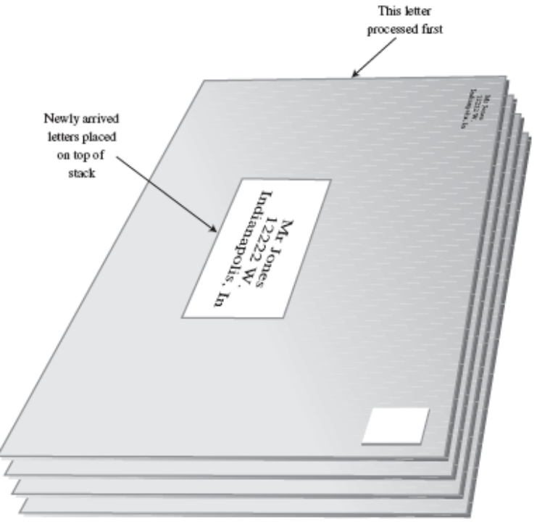
Stacks
The Postal Analogy(一个邮政的模拟例子)
This letter processed first
Newly arrived letters
placed on top of
stack
“do the top one first”

Slide 7
Stacks
Another stack analogy
Push
Pop
Project A：做功课
Project D
Project C
Project B：宵夜
Project B：宵夜
Project B
Project A
Project A
Project C：跟老乡聊天
Project C：跟老乡聊天
Last-In-First-Out (LIFO)
Project D：接电话

Slide 8
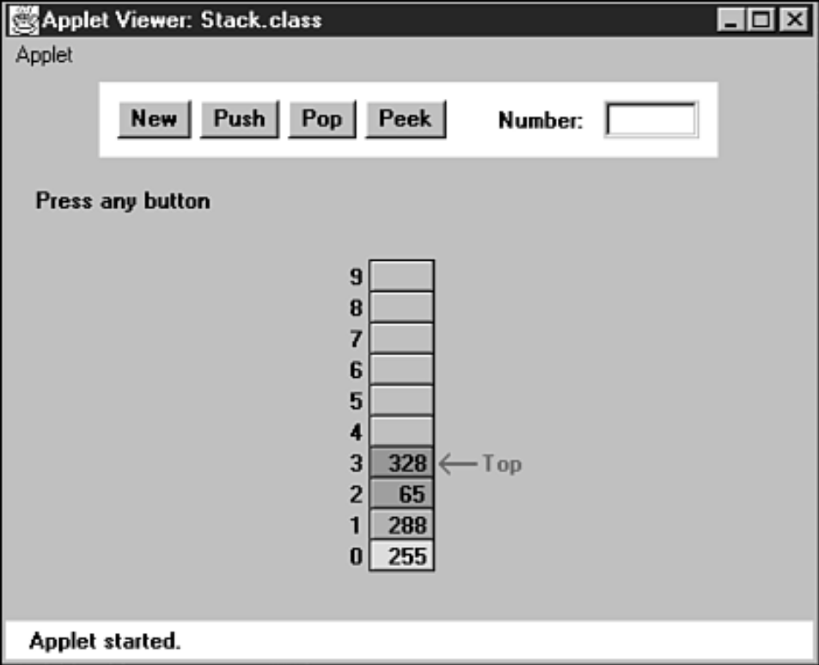
Stacks
The Stack Workshop Applet
The New Button
The Push Button
The Pop Button
The Peek Button
Read the value from the top of the stack without removing it.

Slide 9
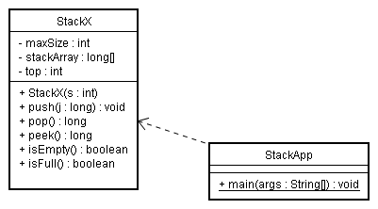
Stacks
Java Code for a Stack
StackX implements a stack
StackApp contains a short main() routine to exercise it.
It creates a stack that can hold 10 items, pushes 4 items onto the stack, and then displays all the items by popping them off
the stack until it’s empty.

Slide 10
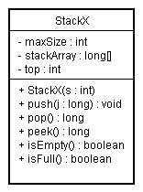
Stacks
StackX Class Methods
The constructor creates a new stack of a size specified in its argument
.
The push() method increments top so it points to the space just above the previous top and stores a data item there.
The pop() method returns the value at top and then decrements top.
The peek() method simply returns the value at top, without changing the stack.
Source Codes
The isEmpty() and isFull() methods return true if the stack is empty or full, respectively.·

Slide 11
Stacks
Error Handling
If you try to push an item onto a stack that’s already full or pop an item from a stack that’s empty?
We’ve left the responsibility for handling such errors up to the class user. The user should always check to be sure the stack is not full before inserting an item:
Many stack classes check for these errors internally, in the push() and pop() methods.
A good solution for a stack class that discovers such errors is to throw an exception(抛出异常)
if( !theStack.isFull() )
insert(item);
else
System.out.print(“Can’t insert, stack is full”);

Slide 12
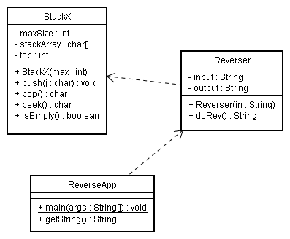
Stacks
Stack Example 1: Reversing a Word
Because of its Last-In-First-Out characteristic, the stack reverses the order of the characters.

Slide 13

Stacks
Stack Example 2: Delimiter Matching（分隔符匹配检查）
Examples:
c[d] // correct
a{b[c]d}e // correct
a{b(c]d}e // not correct; ] doesn’t match (
a[b{c}d]e} // not correct; nothing matches final }
a{b(c) // not correct; nothing matches opening {
讨论：
如何判断合法的字符串？
如何借助Stack实现？
RULE：对于合法的字符串，对于已经扫描到
尚未匹配的左括号L集合{L₁,L₂,…,L_{i}}中，与之
匹配的右括号R出现的次序是{R_{i},…,R₂,R₁}

Slide 14
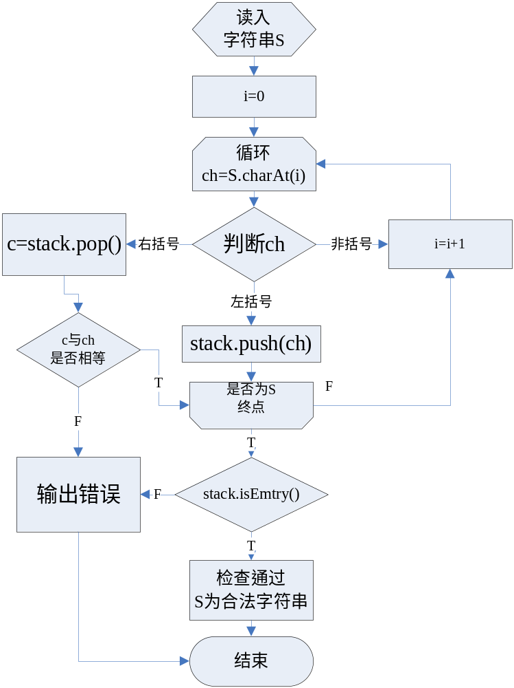

Opening Delimiters on the Stack
Reading characters from the string.
Placing opening delimiters when it finds them, on a stack.
When it reads a closing delimiter from the input, it pops the opening delimiter from the top of the stack and attempts to match it with the closing delimiter.
If they’re not the same type, an error occurs.
If there is no opening delimiter on the stack to match a closing one, or if a delimiter has not been matched, an error occurs.
A delimiter remains on the stack after all the characters in the string have been read.

Slide 15
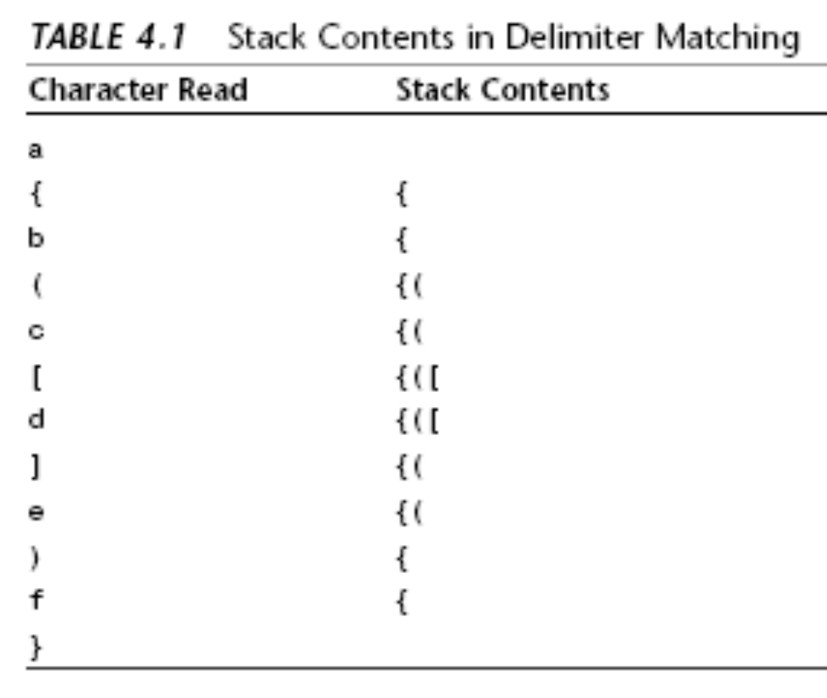
Stacks
Let’s see what happens on the stack for a typical correct string:
a{b(c[d]e)f}
Java Code for brackets.java

Slide 16
Stacks
Efficiency of Stacks
Items can be both pushed and popped from the stack implemented in the StackX class in constant O(1) time.
That is, the time is not dependent on how many items are in the stack and is therefore very quick. No comparisons or moves are necessary.

Slide 17
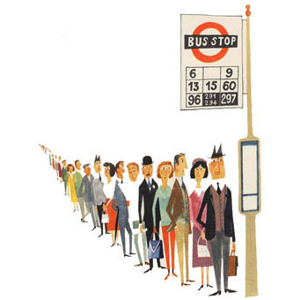
Queues
In a queue the first item inserted is the first to be removed (First-In-First-Out, FIFO), while in a stack, the last item inserted is the first to be removed (LIFO).
Queues are used as a programmer’s tool as stacks are. We’ll see an example where a queue helps search a graph in Chapter 13.
They’re also used to model real-world situations such as
People waiting in line at a bus stop,
Airplanes waiting to take off,
Data packets（数据包） waiting to be transmitted over the Internet.
Print jobs waiting for the printer to be available.
…

Slide 18
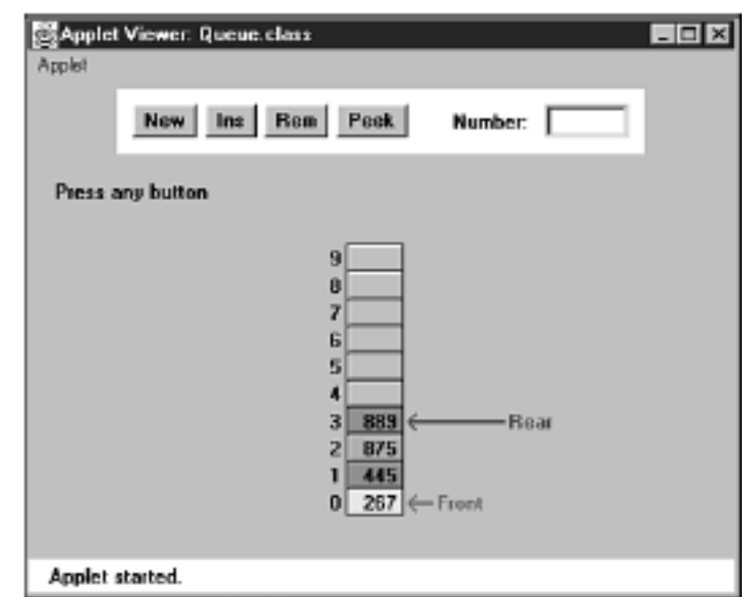
Queues
The Queue Workshop Applet
Unlike stack, the items in a queue don’t always extend all the way down to index 0 in the array. After some items are removed, Front will point at a cell
with a higher index,
What’s the trouble ?

Slide 19
Queues
与现实中队列的差别？
一个元素出队后，之后的元素并不会滚动上前。
只是保证每次调用出队操作时候，返回队头。
一个元素只能占一个数组存储单元，不存在插队情况
其他。。。

Slide 20
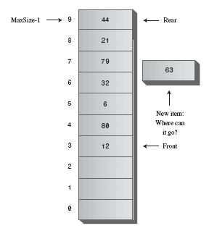
Queues
A Circular Queue
The trouble with this arrangement is that pretty soon the rear of the queue is at the end of the array (the highest index).

Slide 21
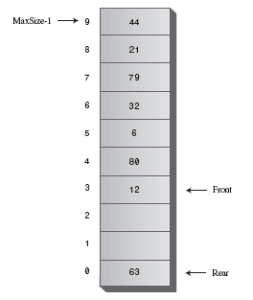
Queues
Wrapping Around（环绕）
The Front and Rear arrows wrap around to the beginning of the
array. The result is a circular queue (sometimes called a ring buffer).

Slide 22
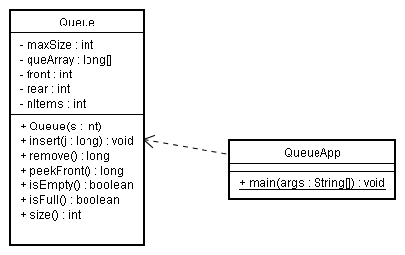
Queues
Java Code for a Queue
Class diagram

Slide 23
Queues
// 入队
public void insert(long j) // put item at rear of queue
{
if(rear == maxSize-1) // deal with wrap around
rear = -1;
queArray[++rear] = j; // increment rear and insert
nItems++; // one more item
}
Assumes that the queue is not full
Assumes that the queue is not empty
//出队
public long remove() // take item from front of queue
{
long temp = queArray[front++]; // get value and increase front
if(front == maxSize) // deal with wrap around
front = 0;
nItems--; // one less item
return temp;
}

Slide 24
Queues
Implementation Without an Item Count
If you’re dealing with huge numbers of insertions and deletions, it might influence performance.
New Problems：
How to count item number？如何计算元素个数？
How to figure out whether the queue is empty or full？如何确定队空（满）？

Slide 25
 | 无环绕 | 环绕
队空
队满
N-1
Rear
…
Front
Rear
0
Front
Rear+1==Front
Front+maxSize-1==Rear
87
Rear
564
69
69
Rear
69
454
454
454
…
665
665
665
Front
455
455
456
456
456
Rear
45
45
45
56
Front
56
56
87
Front
87
Rear==Front+maxSize-2
Rear+2==Front

Slide 26
Queues
public boolean isEmpty()//true if queue is empty
{
return (rear+1==front||(front+maxSize-1==rear));
}
//--------------------------------------------------------------
public boolean isFull() //true if queue is full
{
return ( rear+2==front||(front+maxSize-2==rear));
}
//--------------------------------------------------------------
public int size()//(assumes queue not empty)
{
if(rear >= front) // contiguous sequence，无环绕
return rear-front+1;
else // broken sequence
return (maxSize-front) + (rear+1);
}
Solution
This problem can be solved by making the array one cell larger than the maximum number of items that will be placed in it.

Slide 27
Queues
Efficiency of Queues
As with a stack, items can be inserted and removed from a queue in O(1) time.
Deques（双端队列，提供insertLeft,reomveLeft,insertRight,removeRight方法）
在容器类库中有时会用双端队列来提供栈和队列两种功能。比如禁用其中的insertleft，removeleft方法，就可以实现为栈，队列呢？

Slide 28
Priority Queues
A more specialized data structure than a stack or a queue.
A useful tool in a surprising number of situations.
http://en.wikipedia.org/wiki/Priority_queue
Bandwidth management（带宽管理）
Discrete event simulation（离散事件模拟）
A* and SMA* search algorithms
ROAM(Real-time Optimally Adapting Meshes ) triangulation algorithm
It also has a front and a rear, and items are removed from the front.
However, in a priority queue, items are ordered by key value so that the item with the lowest key (or in some implementations the highest key) is always at the front.
Items are inserted in the proper position to maintain the order.

Slide 29
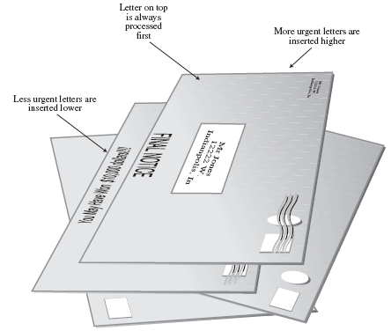
Priority Queues
Letters in a priority queue
Letter on top is always
processed first
More urgent letters are
inserted higher
Less urgent letters
are inserted lower

Slide 30
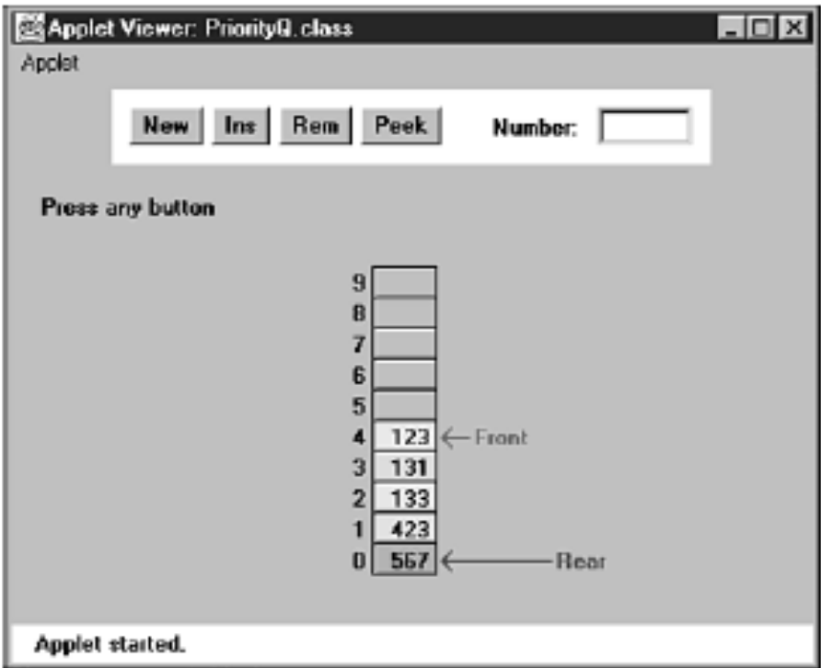
Priority Queues
The PriorityQ Workshop Applet
Note:
No wraparound
Insertion is slow
Deletion is fast.
The Rear arrow never moves

Slide 31
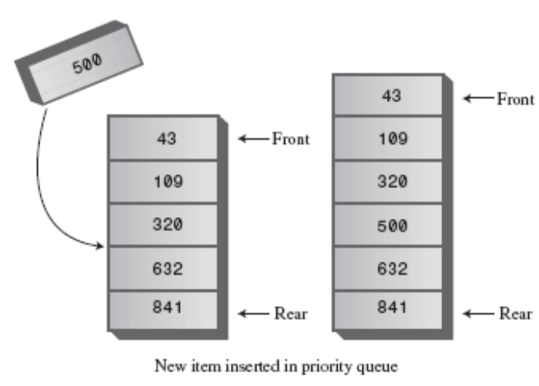
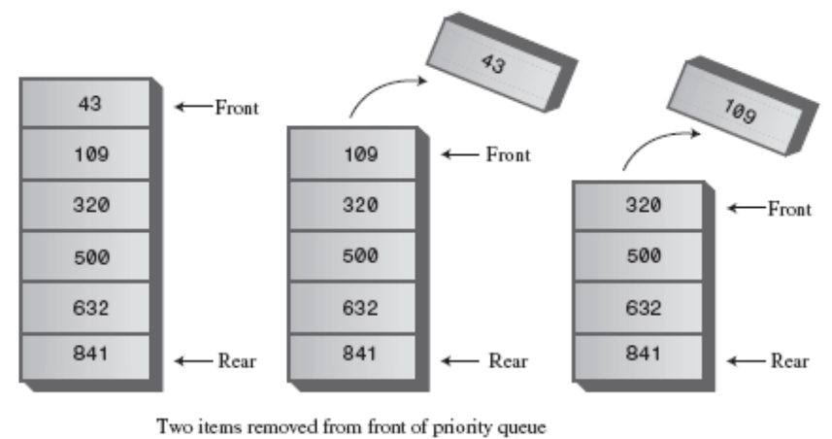
Priority Queues
Insert item
Delete item
For larger numbers of items, or when speed is critical, the heap (堆)is a better choice.

Slide 32
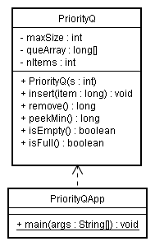
Priority Queues
Java Code for a Priority Queue
Find the place where the new item should go. Then it inserts the item and increments nItems.
Decrements nItems and returns the item
from the top of the array.
Similar to remove method, except it doesn’t decrement nItems.
Check if nItems is 0 or maxSize,
respectively.`
Insert five items in random order, and then remove and display them.

Slide 33
Priority Queues
Efficiency of Priority Queues
Insertion runs in O(N) time, while deletion takes O(1) time.
We’ll see how to improve insertion time with heaps in Chapter 12

Slide 34


Parsing Arithmetic Expressions
In the brackets.java program, we saw how a stack could be used to check whether delimiters （括号）were formatted correctly.
Stacks are used in a similar, although more complicated, way for parsing arithmetic expressions（解析算术表达式）.
For a human it’s easier to parse the ordinary arithmetic expression directly.
For computer, it is a two-step process:
1. Transform the arithmetic expression into a different format, called postfix notation（后缀表达式）.
2. Evaluate the postfix expression.（对后缀表达式求值）

Slide 35
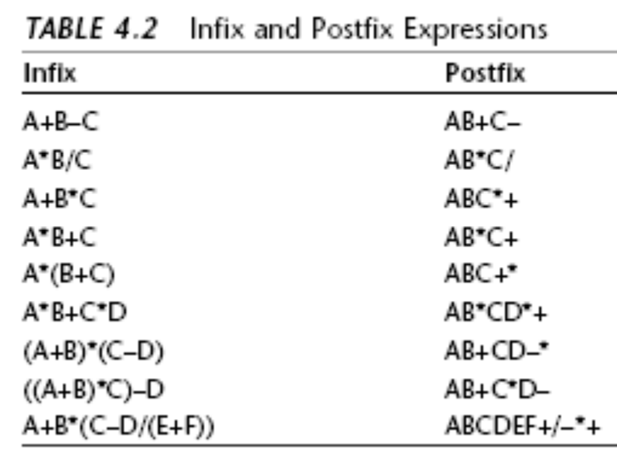
Parsing Arithmetic Expressions
Postfix Notation
operator -----(+, –, *, or /) 运算符
Operands(操作数) ----numbers, or symbols that stand for numbers).
Besides infix and postfix, there’s also a prefix notation

Slide 36
Parsing Arithmetic Expressions
Translating Infix to Postfix
How Humans Evaluate Infix？
1. You read from left to right. (At least, we’ll assume this is true. Sometimes people skip ahead, but for purposes of this discussion, you should assume you must read methodically, starting at the left.)
2. When you’ve read enough to evaluate two operands and an operator, you do the calculation and substitute the answer for these two operands and operator.
(You may also need to solve other pending operations on the left, as we’ll see later.)
3. You continue this process—going from left to right and evaluating when possible—until the end of the expression.

Slide 37
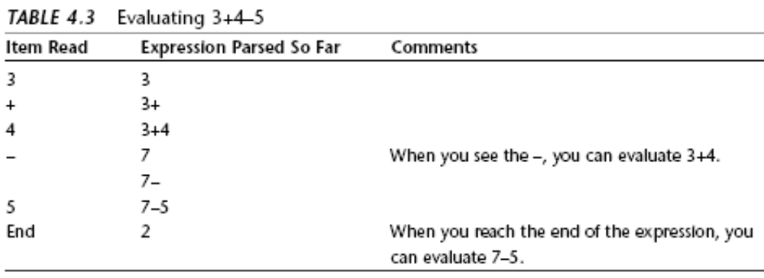
Parsing Arithmetic Expressions
How Humans Evaluate Infix
You can’t evaluate the 3+4 until you see what operator follows the 4.

Slide 38
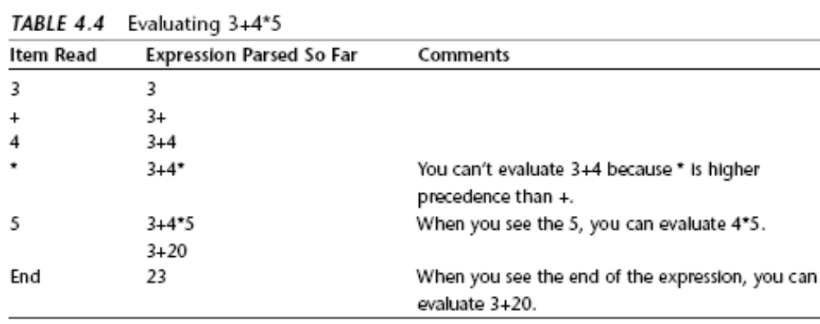
Parsing Arithmetic Expressions
Here you can’t add the 3 until you know the result of 4*5.

Slide 39
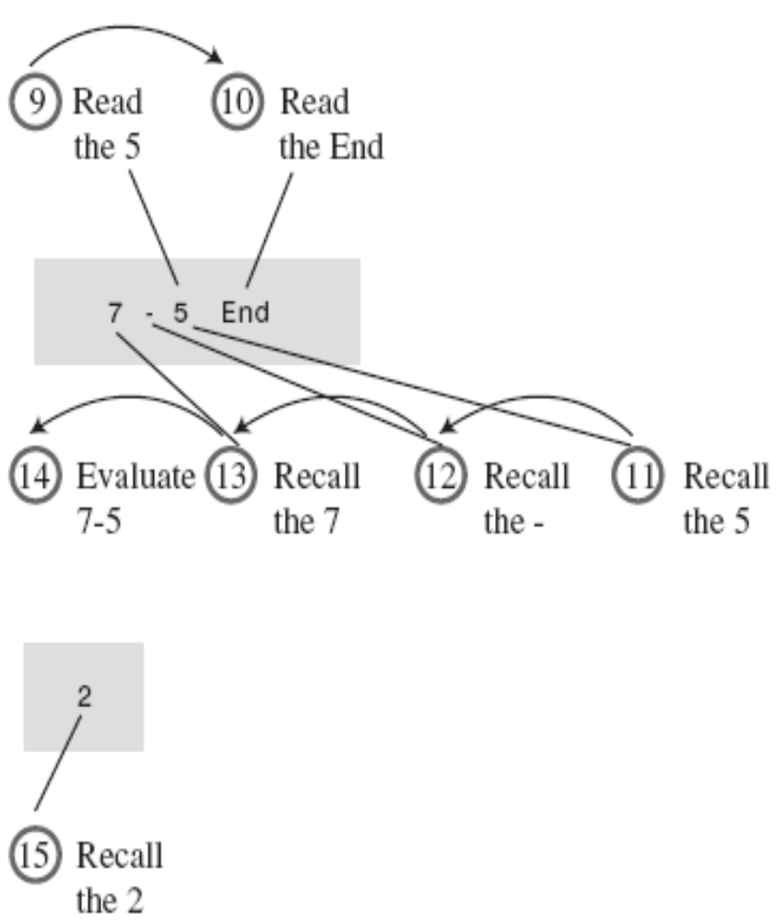
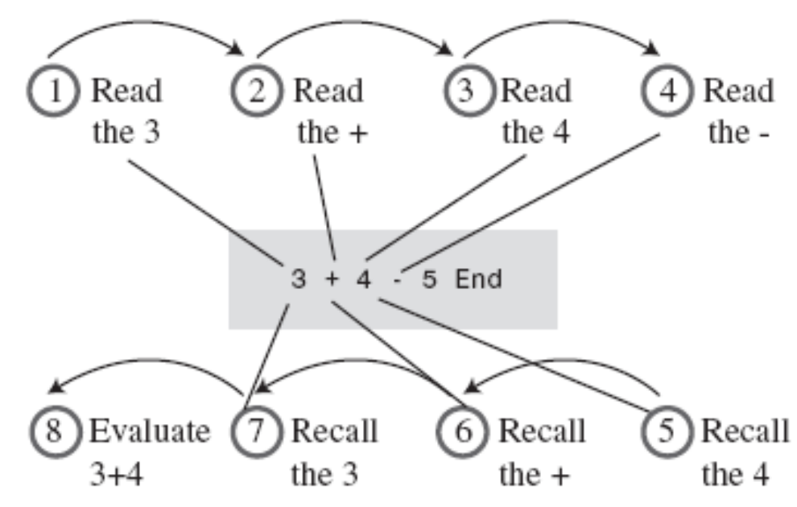
Parsing Arithmetic Expressions
Details of evaluating 3+4–5.

Slide 40
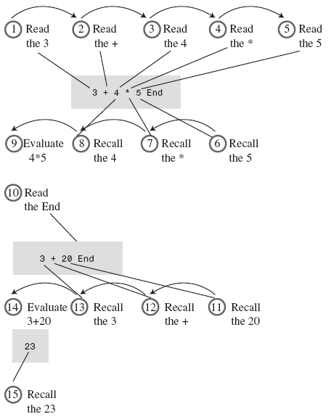
Parsing Arithmetic Expressions
Details of
evaluating 3+4*5.

Slide 41
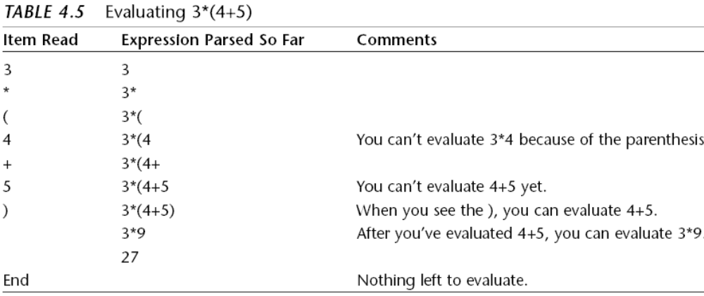
Parsing Arithmetic Expressions
Here we can’t evaluate anything until we’ve reached the closing parenthesis（右括号）.

Slide 42
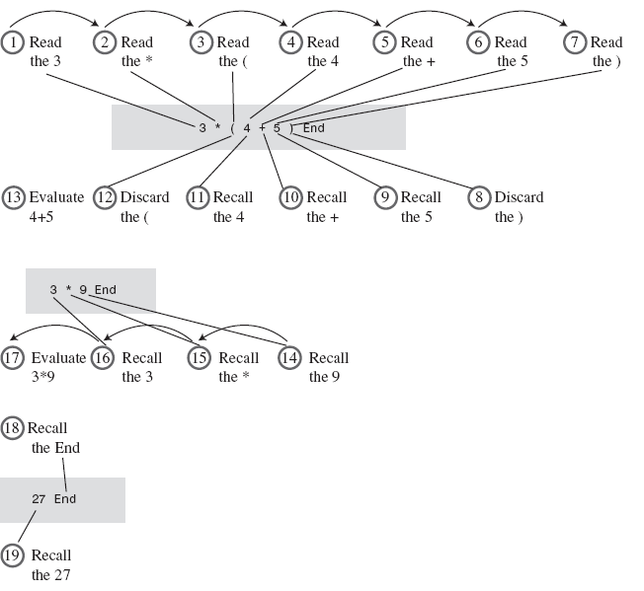
Details of evaluating 3*(4+5).
We could write an algorithm to carry out this kind of evaluation directly. However, it’s actually easier to translate into postfix notation first.
Two Main Step to evaluate
You go forward (left to right) reading operands and operators.
When you have enough information to apply an operator, you go backward, recalling two operands and an operator and carrying out the arithmetic.

Slide 43
Parsing Arithmetic Expressions
How Humans Translate Infix to Postfix
The idea is
Rearrange the operators and operands into a different format: postfix notation.
As before, you read the infix from left to right, looking at each character in turn.
The trick is knowing when to copy what. (诀窍是知道什么时候拷贝谁)
Rules
1.如果当前字符是操作数，立即拷贝入posfix字符串中。
2.如果当前为运算符，而且可以立即用于计算中缀表达式，将其拷贝入pofix。

Slide 44
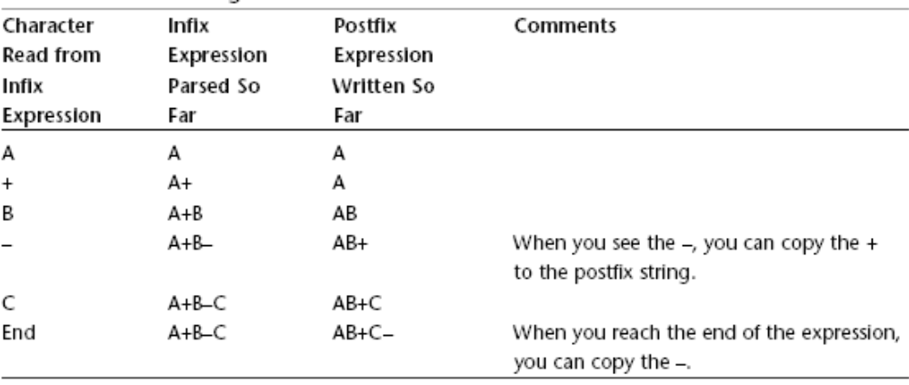
Parsing Arithmetic Expressions
Translating A+B–C into Postfix

Slide 45
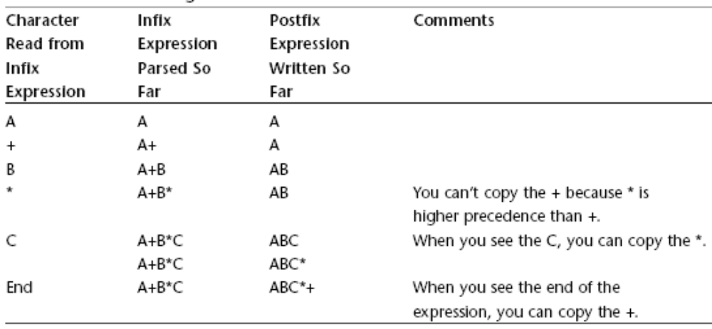
Parsing Arithmetic Expressions
Translating A+B*C to Postfix

Slide 46
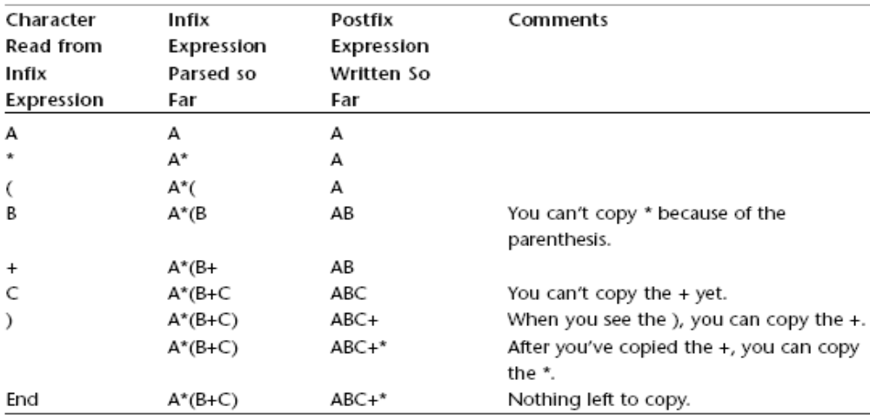
Parsing Arithmetic Expressions
Translating A*(B+C) into Postfix
You can’t write any postfix operators until you see the closing parenthesis in the input.

Slide 47
Parsing Arithmetic Expressions
小结
1、在转换过程中，仍需要向前和向后扫描infix expression；
2、当某个operator后面是优先级更高的operator或者为左括号时，就不能把这个operand输出到postfix。高优先级别的operand必须要比低优先级别的operand先写到postfix中去

Slide 48
Parsing Arithmetic Expressions
Saving Operators on a Stack
In the two examples, the order of the operators is reversed going from infix to postfix. Because the first operator can’t be copied to the output until the second one has been copied, the operators were output to the postfix string in the opposite order （相反的次序）they were read from the infix string.

Slide 49
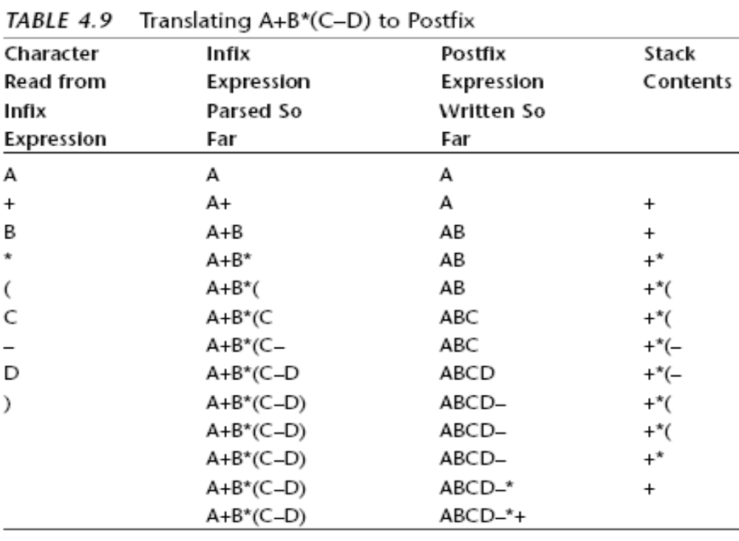
The order of the operands is +*– ,in the original infix expression,
The reverse order is –*+, in the final postfix expression.
This happens because * has higher precedence than +, and –, because it’s in parentheses, has higher precedence than *.
A stack might be a good place to store the operators while we’re waiting to use them.

Slide 50
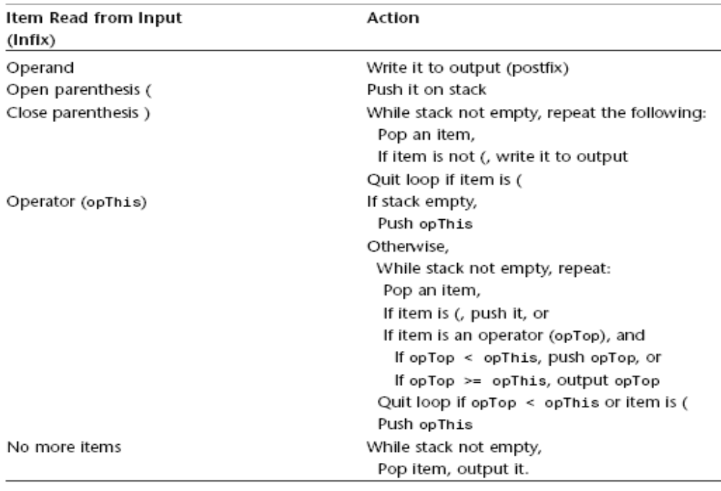
Translation Rules

Slide 51
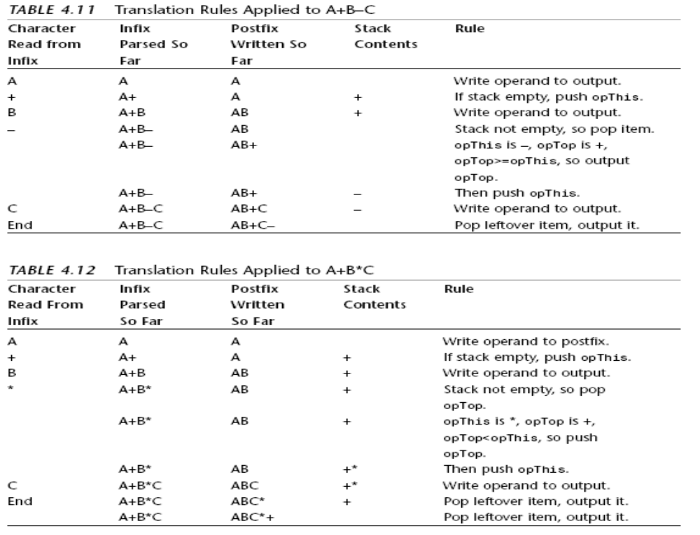

Slide 52
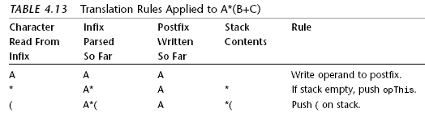
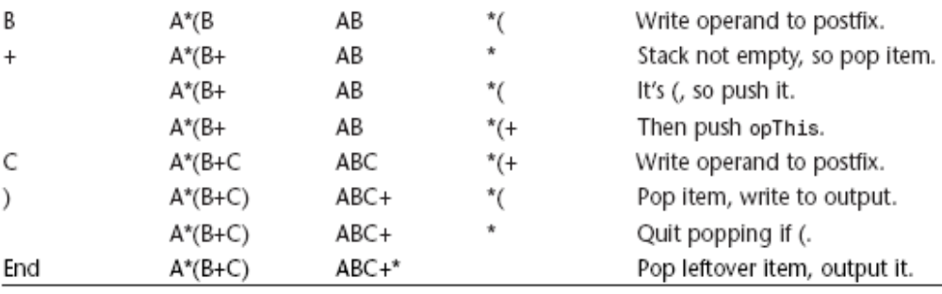

Slide 53
Parsing Arithmetic Expressions
Java Code to Convert Infix to Postfix
The main() routine in the InfixApp class asks the user to enter an infix expression.
The input is read with the readString() utility method. The program creates an InToPost object, initialized with the input string.
Then it calls the doTrans() method for this object to perform the translation. This method returns the postfix output string, which is displayed.

Slide 54
Parsing Arithmetic Expressions
Evaluating Postfix Expressions
How Humans Evaluate Postfix
Visual approach to postfix evaluation of 345+*612+/–.（假设均为个位数）
5
2
4
1
3
3 4 5 + * 6 1 2 + / –

Slide 55
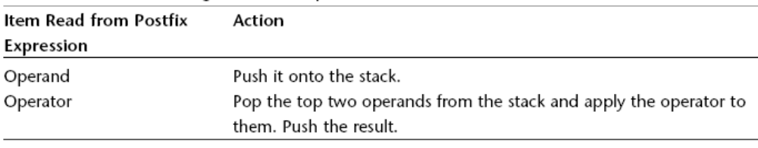
Parsing Arithmetic Expressions
Rules for Postfix Evaluation
Each time you come to an operator, you apply it to the last two operands you’ve seen.

Slide 56
Parsing Arithmetic Expressions
Java Code to Evaluate Postfix Expressions
The main() method in the PostfixApp class gets the postfix string from the user and then creates a ParsePost object, initialized with this string. It then calls the doParse() method of ParsePost to carry out the evaluation.
The doParse() method reads through the input string character by character. If the character is a digit, it’s pushed onto the stack. If it’s an operator, it’s applied immediately to the two operators on the top of the stack. (These operators are guaranteed to be on the stack already because the input string is in postfix notation.)

Slide 57
Summary
栈、队列和优先级队列是经常用于简化某些程序操作的数据结构。
在这些数据结构中，只有一个数据项可以被访问。
栈允许访问最后一个插入的数据项。
栈中重要的操作是在找顶插入(压入)一个数据项，以及从栈顶移除(弹出)一个数据项。
队列只允许访问第一个插入的数据项。
队列的重要操作是在队尾插入数据项和在队头移除数据项。

Slide 58
队列可以实现为循环队列，它基于数组，数组下标可以从数组末端回绕到数组的开始位置。
优先级队列允许访问最小(或者有时是最大)的数据项。
优先级队列的重要操作是有序地插入新数据项和移除关键字最小的数据项。
这些数据结构可以用数组实现，也可以用其他机制(例如链表)来实现。
普通算术表达式是用中缀表达法表示的，这种命名的原因是操作符写在两个操作数的中间。

Slide 59
Assignment
1.试验workshop中stack的操作，阅读Listing 4.1（Handout P120-122）。并在BlueJ中调试运行程序，尝试修改其中的数据，观察运行结果。
2.设将整数1，2，3，4依次进栈，但只要出栈时栈非空，则可将在某次入栈操作后即执行若干次（1-4次）出栈操作，请回答下述问题：
（1）若入、出栈次序为Push(1), Pop(), Push(2), Push(3), Pop(), Push(4), Pop(), 则出栈的数字序列为何（这里Push(i)表示i进栈，Pop()表示出栈）？
（2）能否得到出栈序列1423和1432？并说明为什么不能得到或者如何得到。
（3）请分析1，2，3，4的24种排列中，哪些序列是可以通过相应的入出栈操作得到的。

Slide 60
The End

